Slide 1





GIT
Fauzi Sholichin
fauzisholih@gmail.com
+6289673732142
https://www.linkedin.com/in/fauzisho/

Slide 2

Why is GIT useful ?

Slide 3
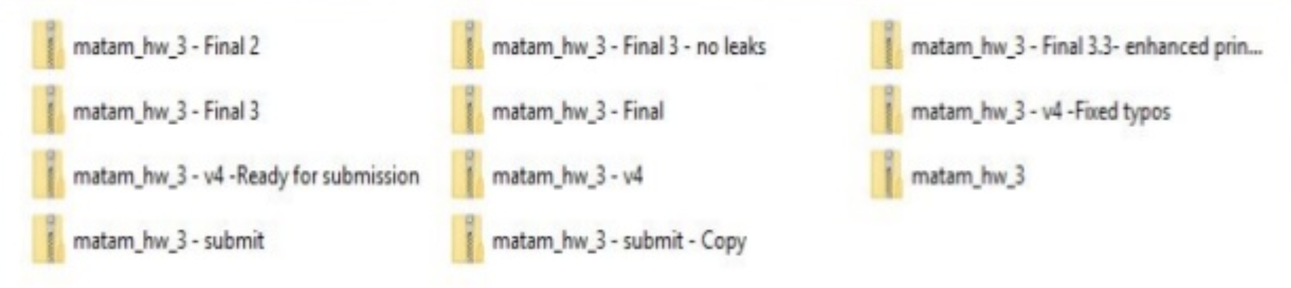
Use Cases

Slide 4
Use Cases
Consider this scenario :
You have a homework submission for today and the assignment is ready for submission
While testing it you discovered a minor bug and decided to fix it

Slide 5
Use Cases
After attempting to do so, you accidentally changed a working code and got yourself in a big mess
You no longer remember what was and what wasn’t there
It is 23 : 58 PM

Slide 6
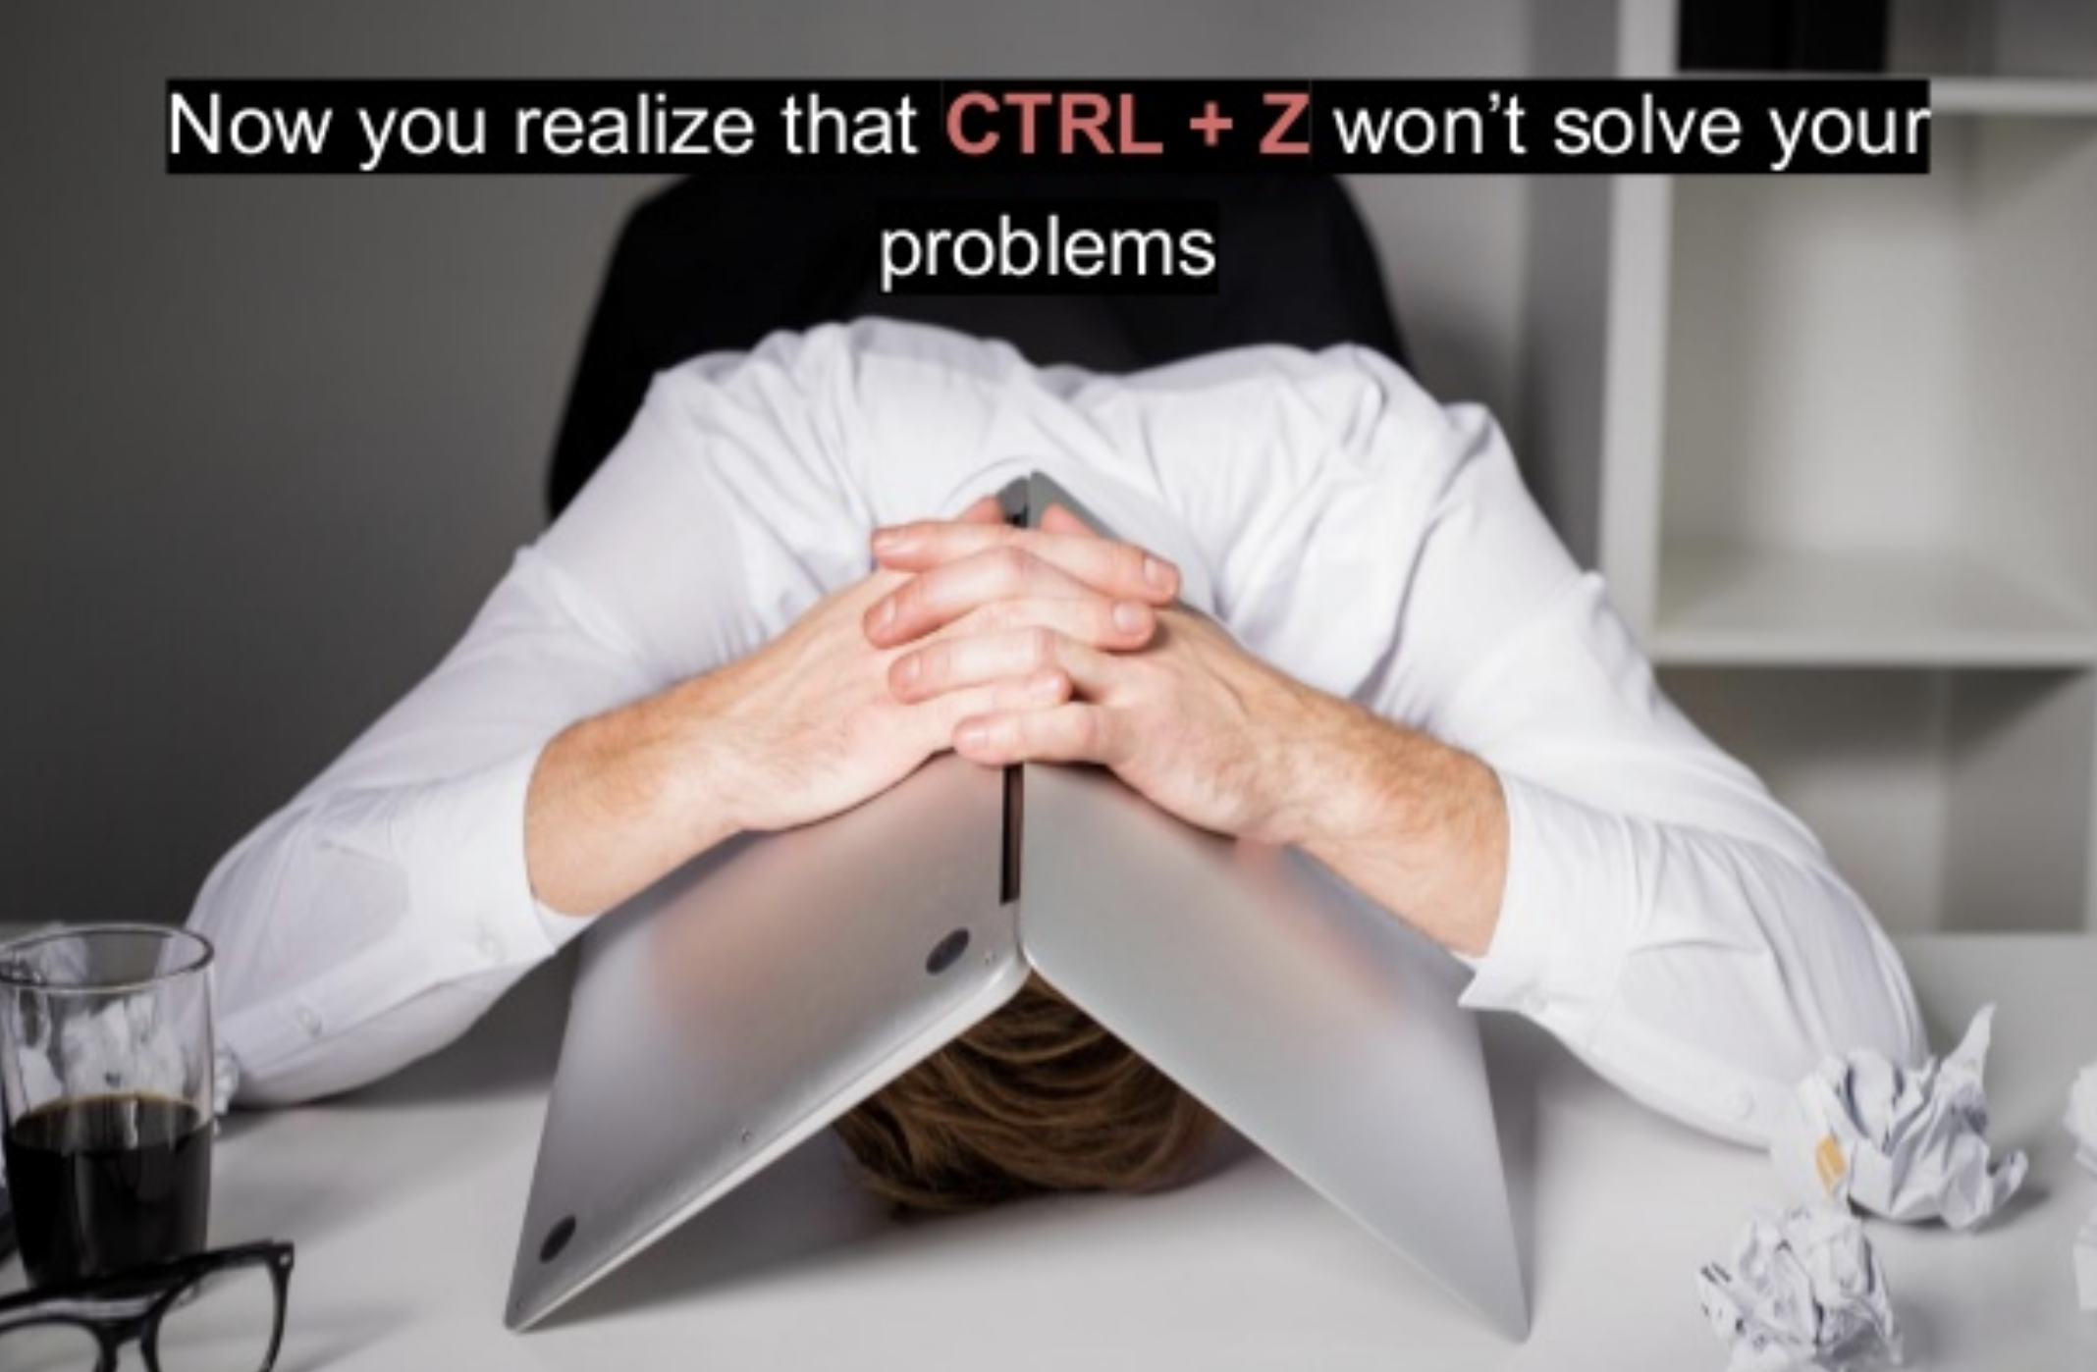
Problem is..

Slide 7
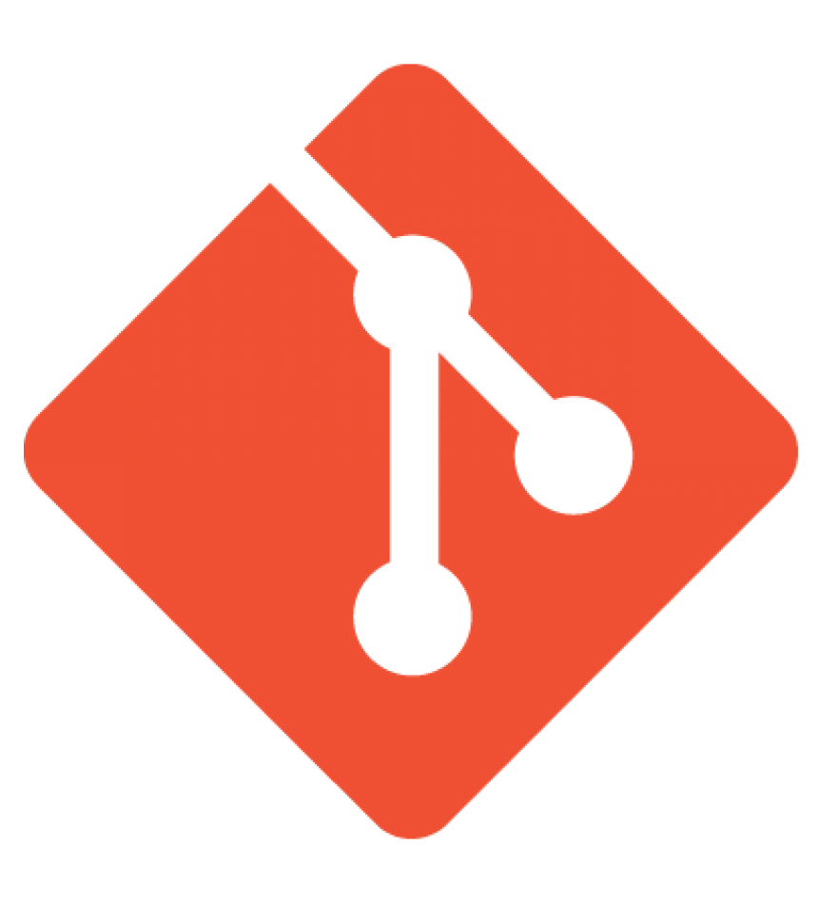
What is git ?
Open source project originally developed in 2005 by Linus Torvalds
A command line utility
A distributed version control system

Slide 8
Git
Version control system : is a system that records changes to a file or set of files over time so that you can recall specific versions later
Distributed : means that there is no main server and all of the full history of the project is available once you cloned the project

Slide 9
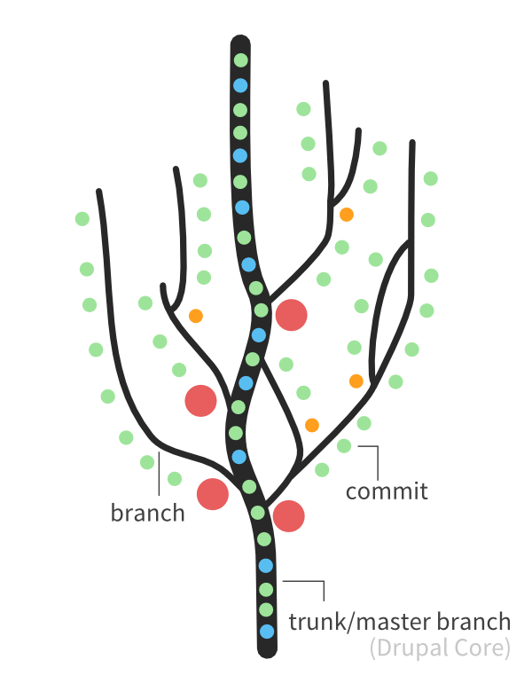
Git
You can imagine git as something that sits on top of your files.
This “something” is a tree structure where each commit creates a new node in that tree

Slide 10
Git Repository

Slide 11
Commit
A commit object mainly contains three things :
A set of changes the commit introduces
Commit message describing the changes
A hash, a 40-character string that uniquely identifies the commit object

Slide 12
Git Workflow
git add
Introduces Changes
Add the changes to staging area
git commit
Make that change “permanent”
Push..
Notes:
Introduce a change : introduce a change to a file that is being tracked by git

Slide 13
Git Command
Initial a new repository : git init
Cloning an existing repository : git clone
Saving changes to the repository : git add and git commit
Inspecting a repository : git status, git log
Repo-to-repo collaboration : git remote, git fetch, git pull, git push
Switching between : git branch, git checkout
Moving contant across : git statsh, git merge, git rebase, git cherry pick
Configuration & set up : git config

Slide 14
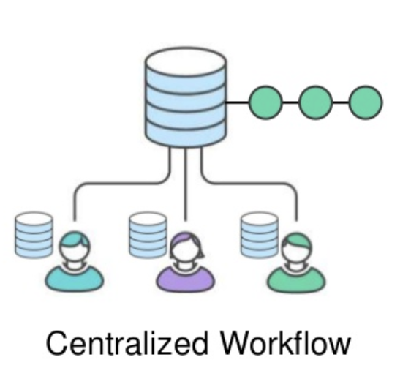
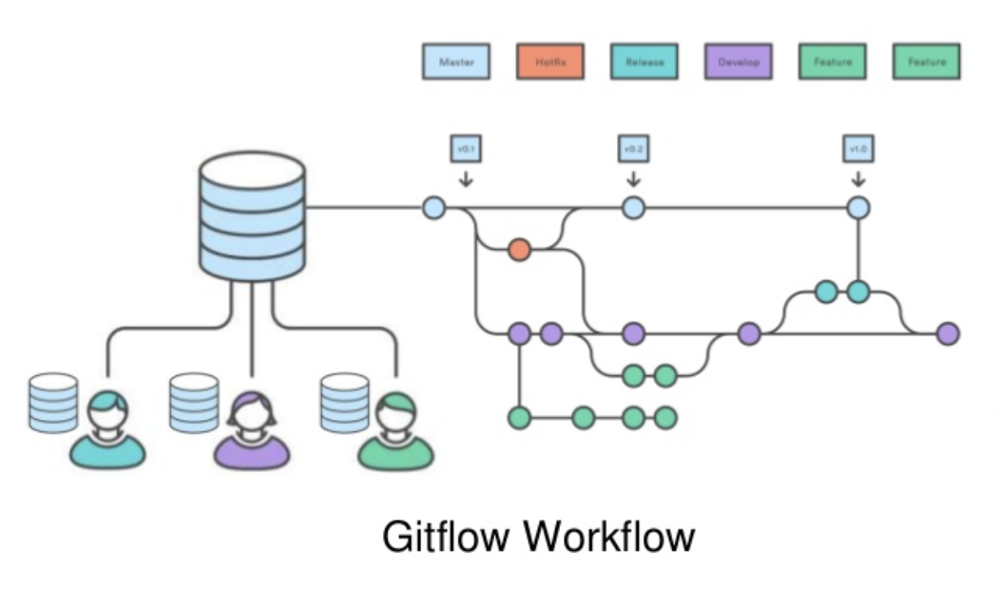
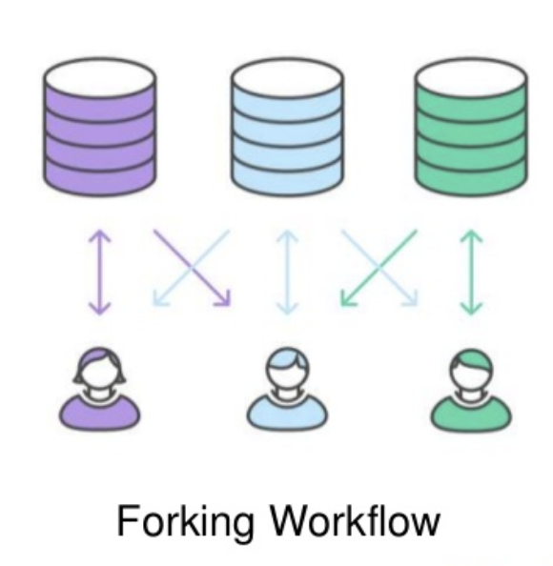
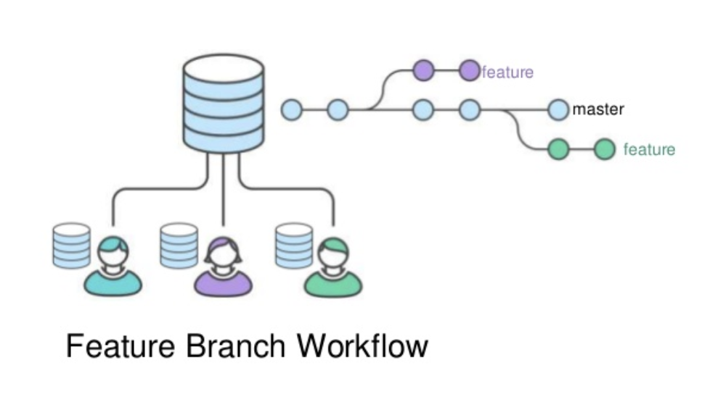
Workflows with Git

Slide 15
Workflows with Git

Slide 16
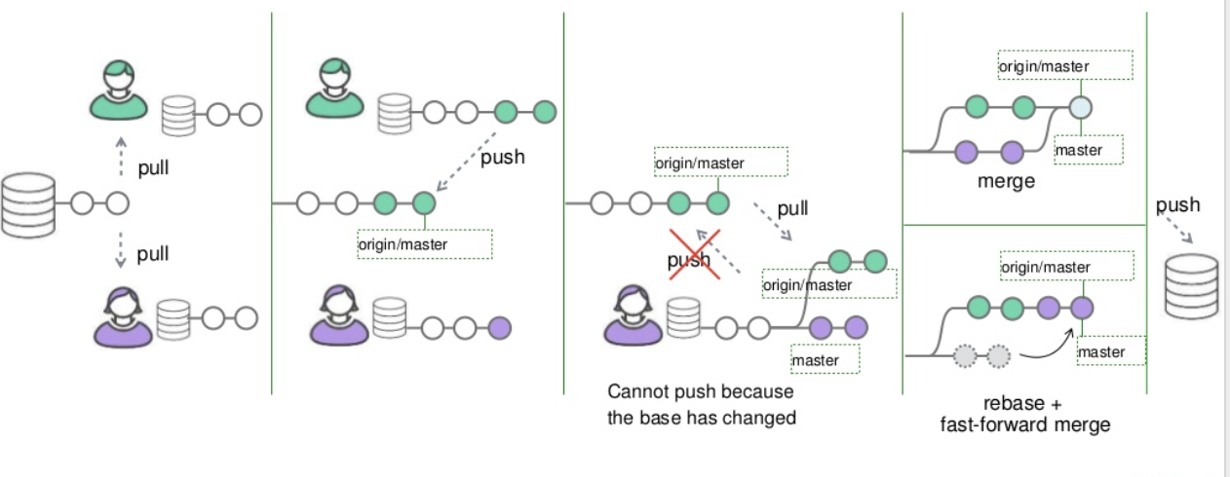
Centralized Workflow

Slide 17
Centralized Workflow
Advantages | Disadvatages
Easy to manage | Everybody working on the same branch
Good for less prone to change project | More conflict if many dev
Good for maintaining project

Slide 18
Feature Branch Workflow
There are :
One master branch
Many features branches (each for a feature)
Each feature is developed on a dedicate branch
A pull request is filed when feature is completed
Feature branch is closed (delete) after finish

Slide 19
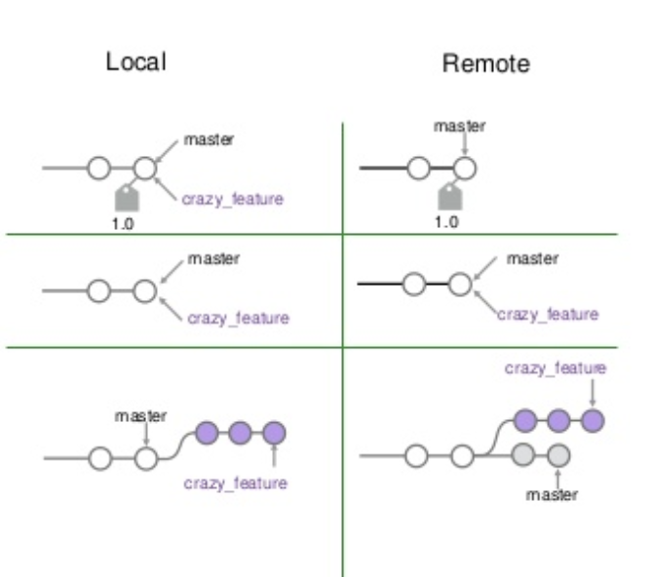
Feature Branch Workflow

Slide 20
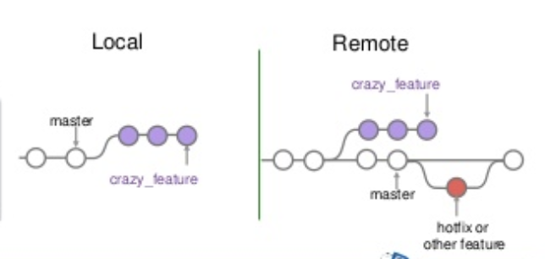
Feature Branch Workflow

Slide 21
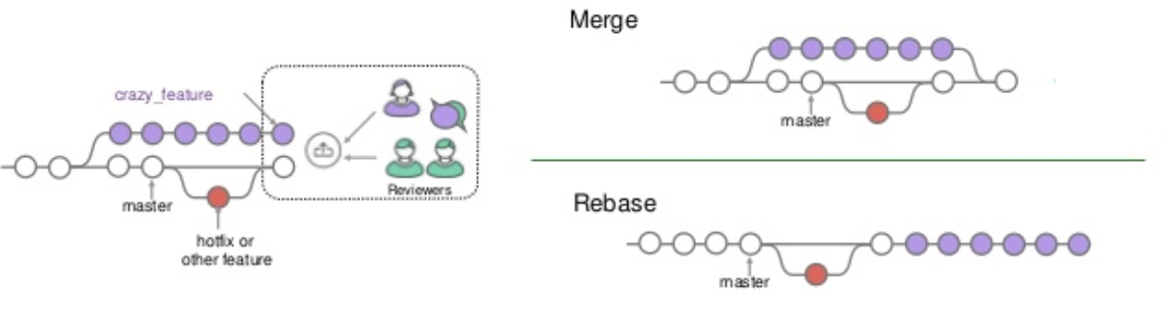
Feature Branch Workflow

Slide 22
Feature Branch Workflow
Advantages | Disadvatages
Relatively easy to manage | Dirty master branch
Code review support | Develop vs. production
Good for internal project (no hand off release to end users) | Feature vs. Hotflix
Notes:
Simple team structre, focus task , few concurrent task

Slide 23
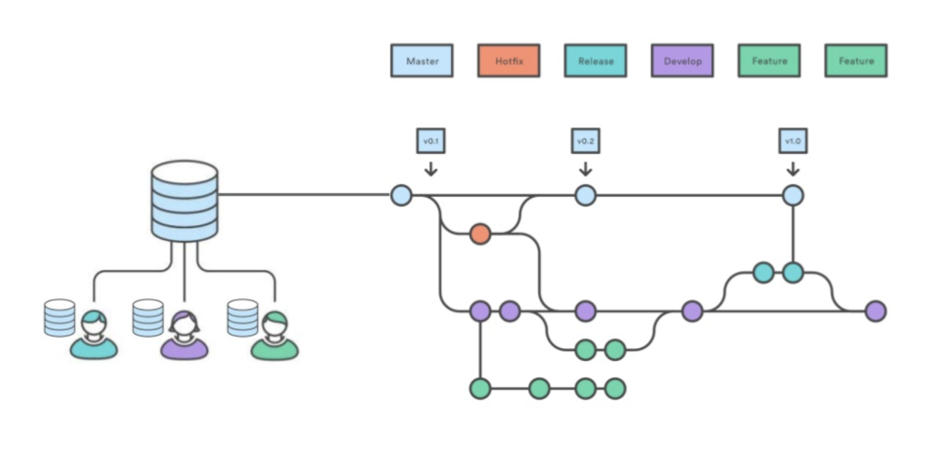
Advance Git-flow Workflow

Slide 24
Git-flow Workflow Anatomy
There are :
One master branch
One develop branch
One temporary branch for each release
One feature branch for each feature
One temporary hotfix branch for each hotfix

Slide 25
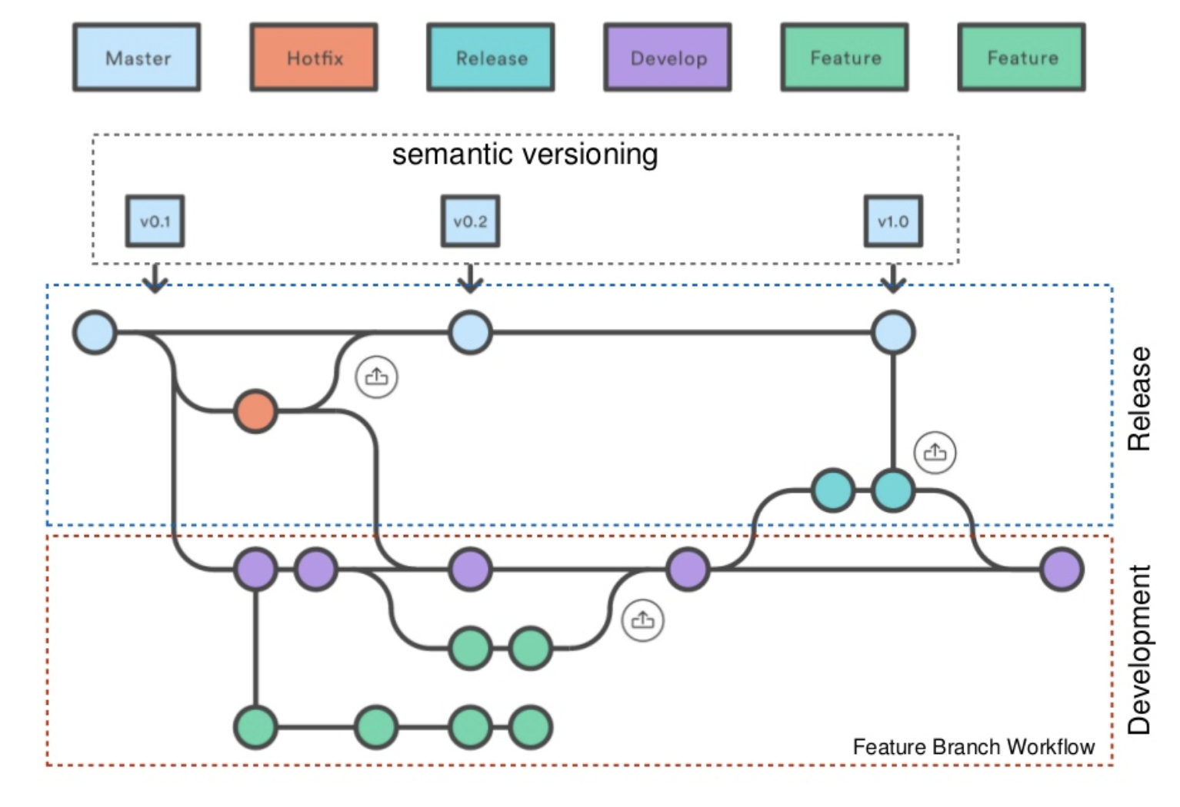
Git-flow Workflow Anatomy

Slide 26
Feature Branch Workflow
Advantages | Disadvatages
Separate release and development | Many branch
Multi thread | Need follow convention to have smooth management
Prevent dirty branch history
Good for end user product with release base
Notes:
Big team, multiple group and concurrent feature, and regulary release

Slide 27
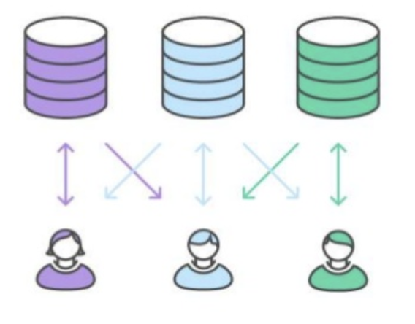
Forking Workflow

Slide 28
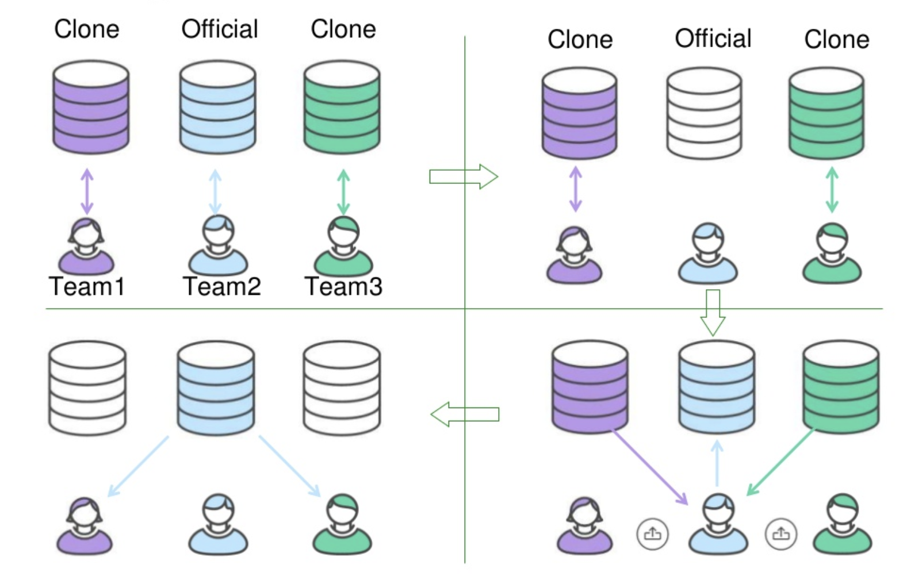
Forking Workflow

Slide 29
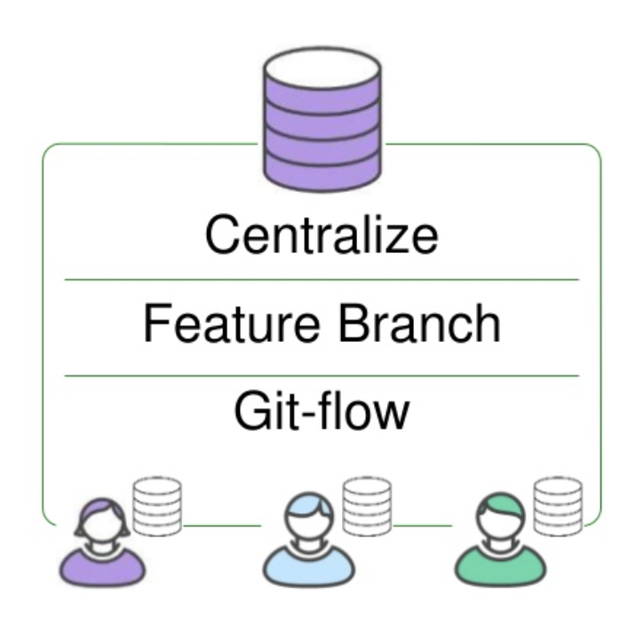
Forking Workflow
Each clone repo can be a central repo
Each many organized as other work flow

Slide 30
Forking Workflow
Advantages | Disadvatages
Open source project | More than one central repo
Large scale project | Huge and distributed
Notes:
Big team, multiple group and concurrent feature, and regulary release

Slide 31
Q & A
Notes:
Big team, multiple group and concurrent feature, and regulary release

Slide 32
How to Manage Projects Using Trello
Fauzi Sholichin
fauzisholih@gmail.com
+6289673732142
https://www.linkedin.com/in/fauzisho/

Slide 33

Let’s start by going to trello.com

Slide 34
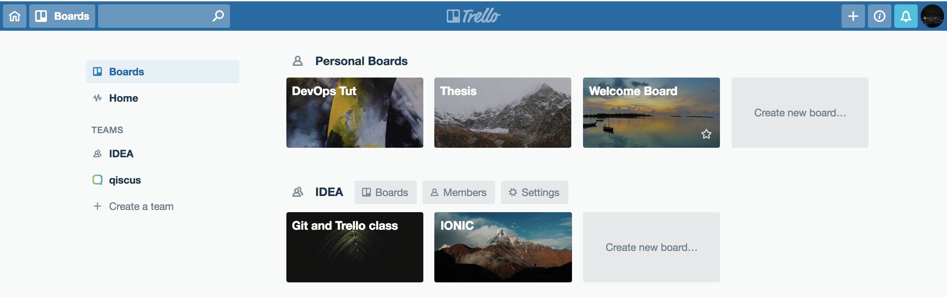
This is called Boards

Slide 35
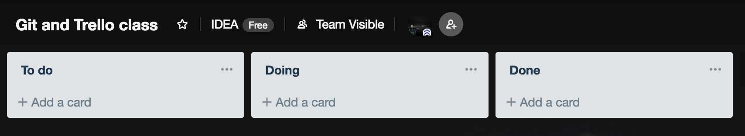
Add list

Slide 36
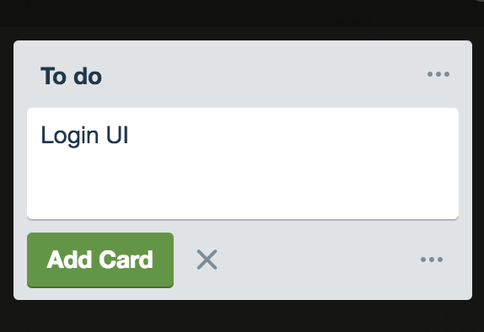
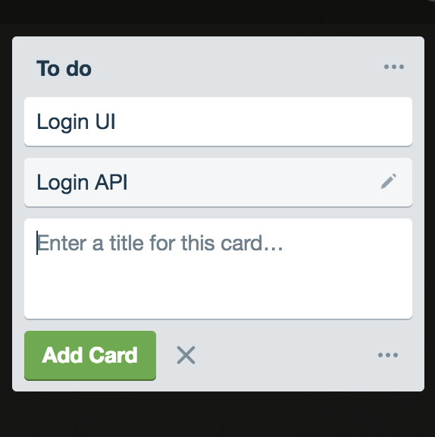
Add Card based on Project Task

Slide 37
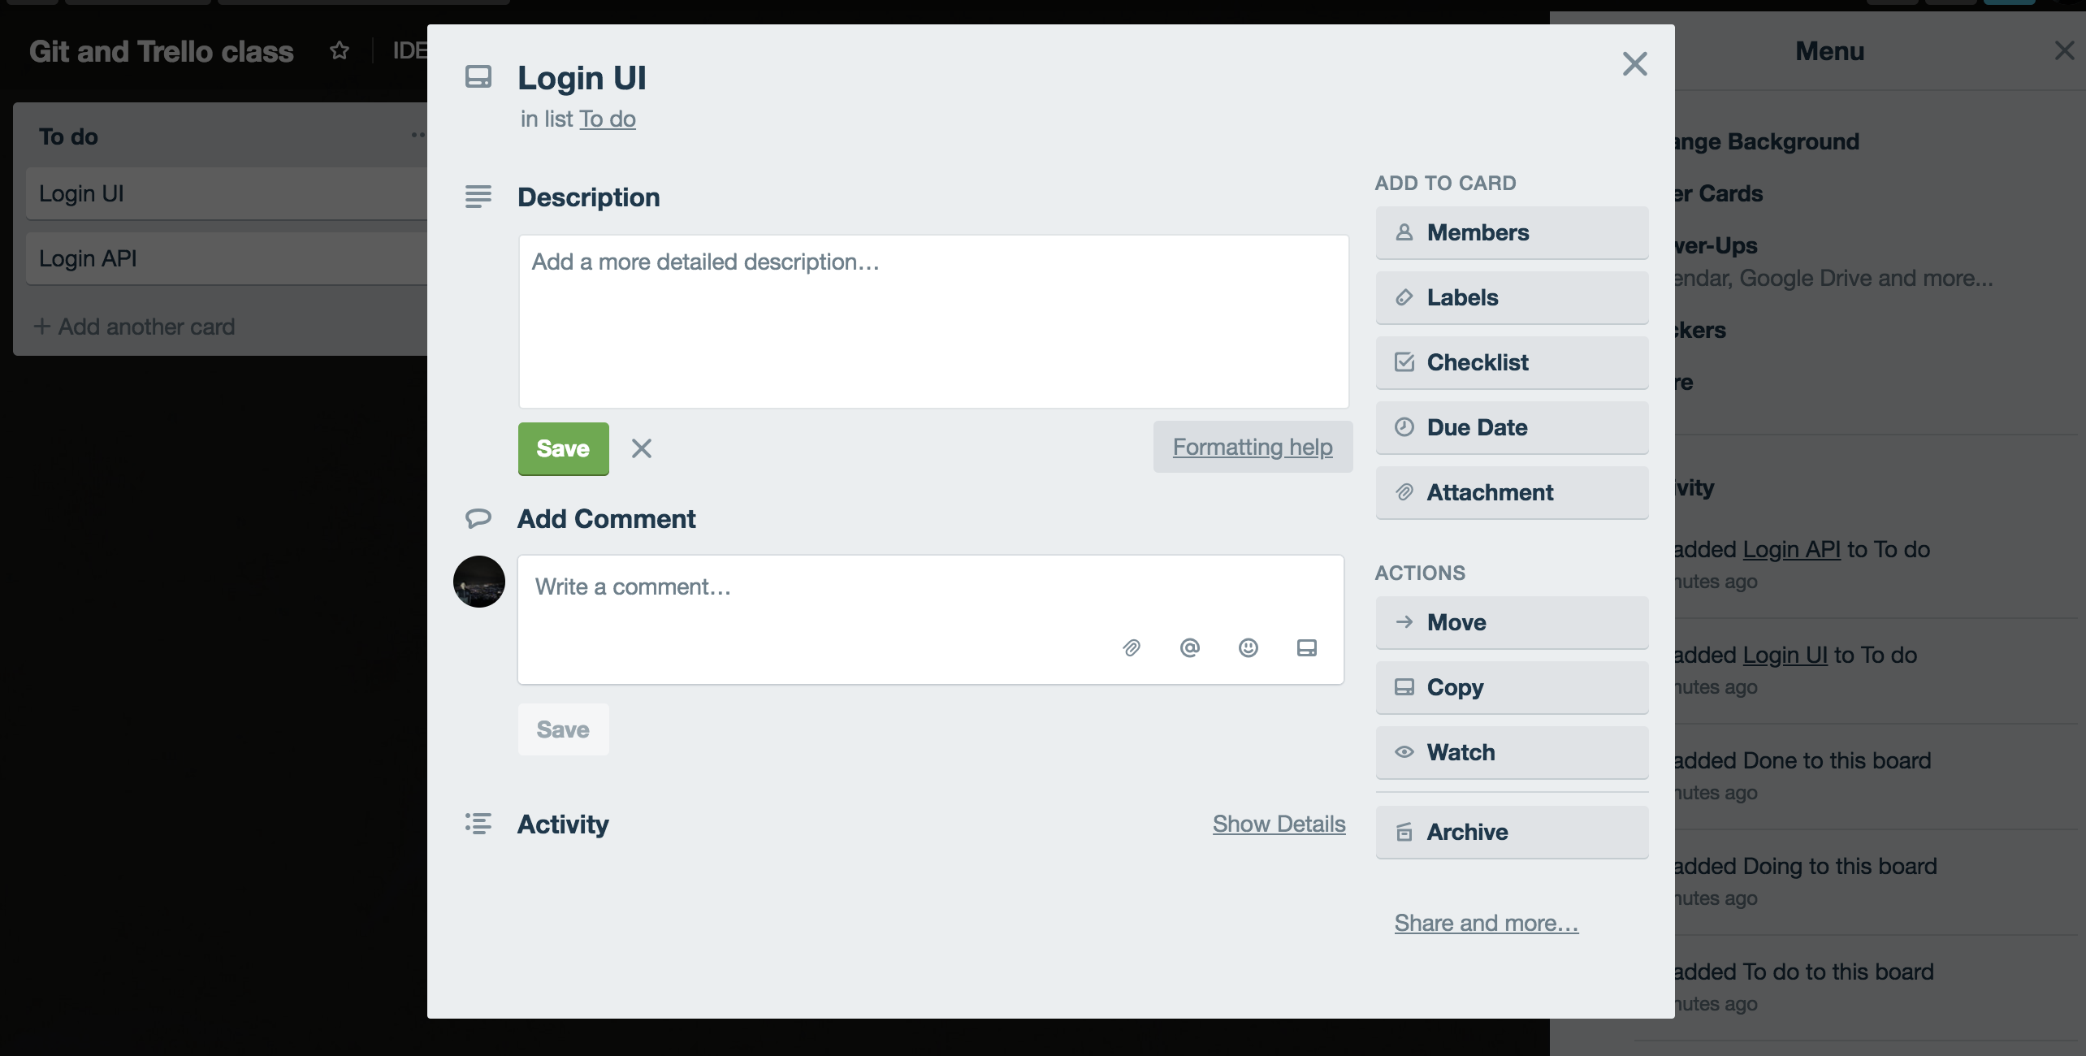
Add Detail of Task

Slide 38
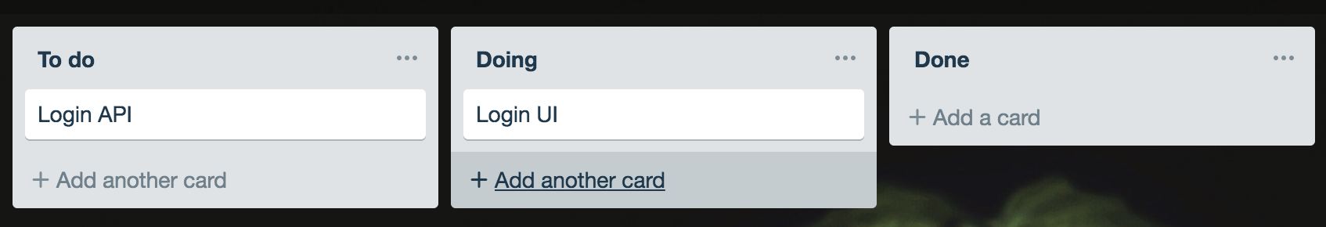
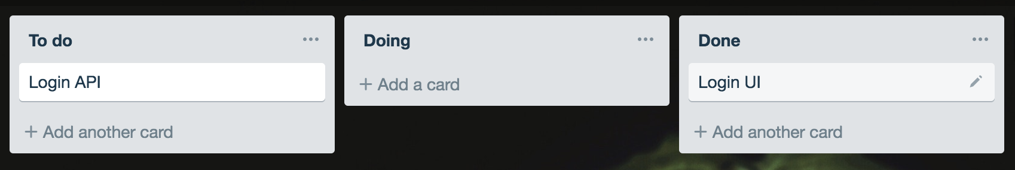
Drag the card when doing or done

Slide 39
Advanced class divided three groups
Course Registration
Leave Application
Financial Status

Slide 40
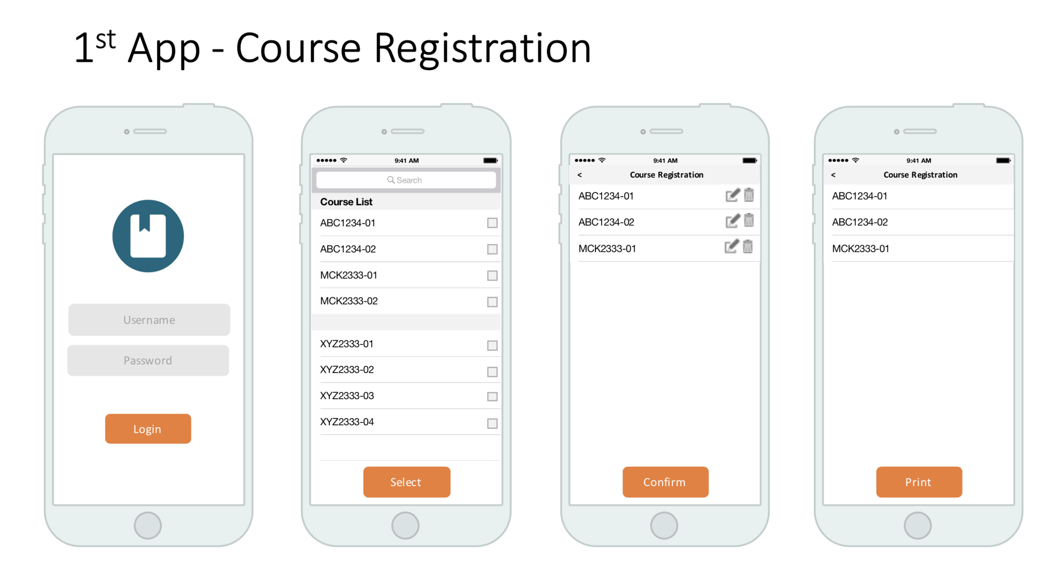
Advanced class divided three groups
Course Registration

Slide 41
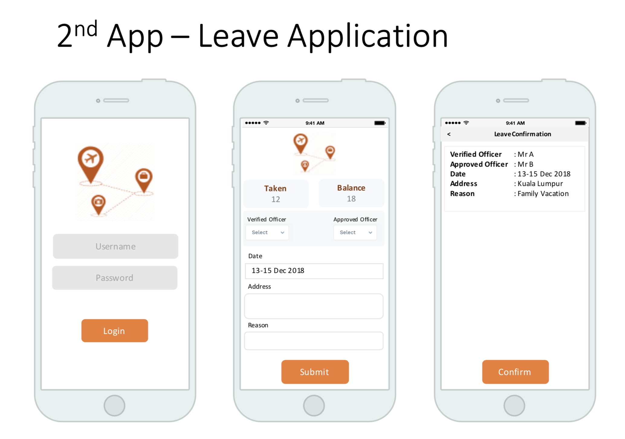

Slide 42
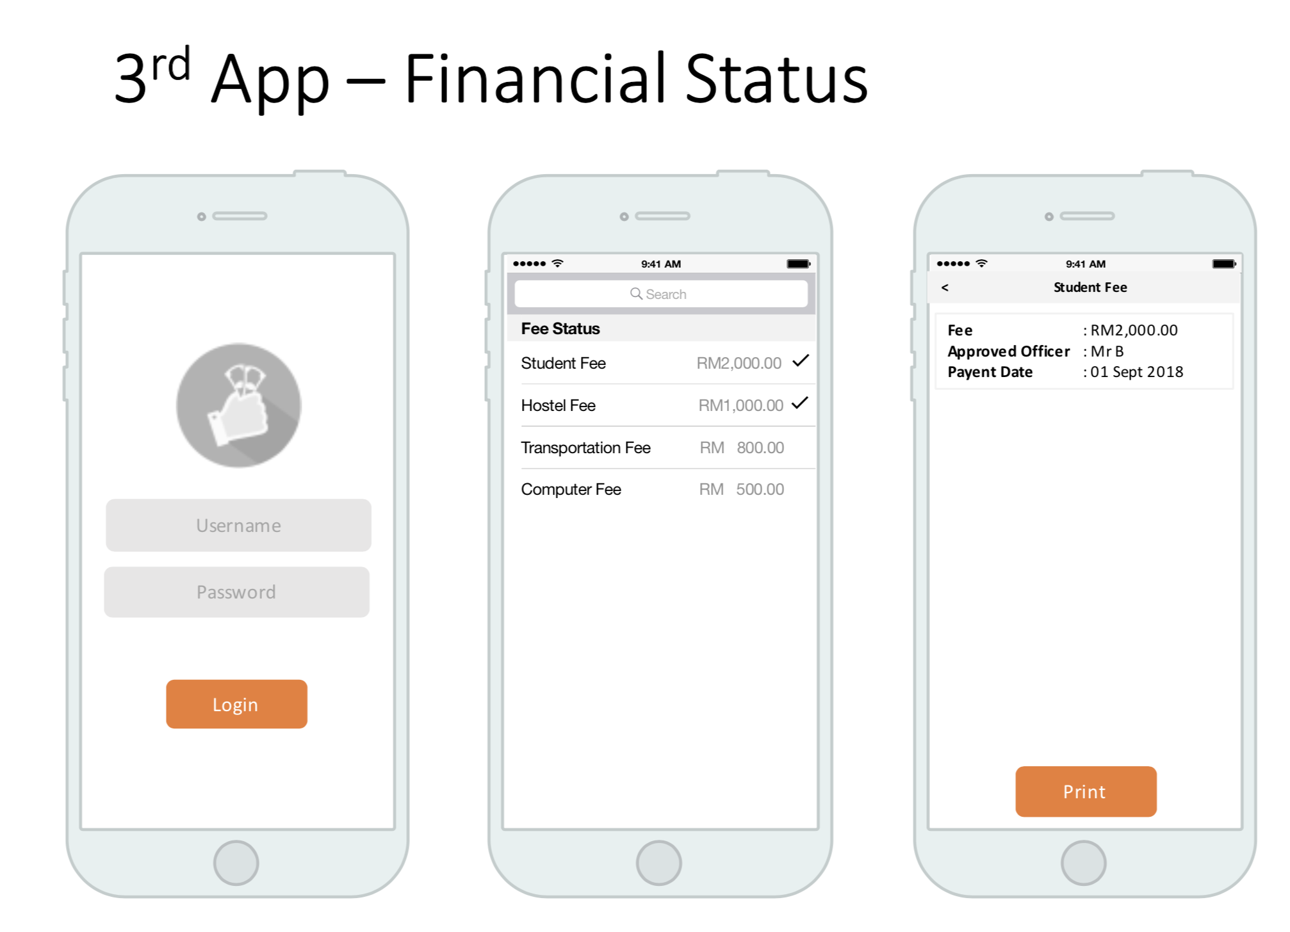

Slide 43
One person would be leader of project
Course Registration Leader : …
Leave Application Leader : …
Financial Status Leader : ….

Slide 44
Setup requirement each Team
Divided based on
Manage Ticket / Task : …
User Interface team : ..
Synchronize data from server: …
Explore Native feature : ...
Or
Manage Ticket / Task :
Develop by feature
Login feature : ….
Crud Feature : …
Explore Native Feature : …

